Slide 1
JNCIS-ENT
Layer 2 switching and VLANs

Slide 2
L2 Switching Lab
9
Monitoring Layer 2 Switching Operations

Slide 3
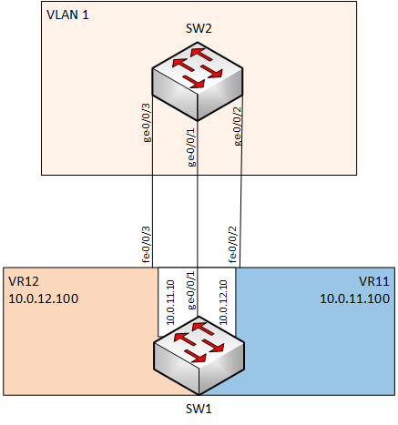
Diagram

Slide 4
Configuring Ethernet Switching
Review the starting configuration on SW1 and SW2
Configure ge-0/0/2 unit 1 on SW2 for ethernet switching
Correct ge-0/0/2 configuration by renaming unit 1 to unit 0
Configure ge-0/0/2 on SW2 as an access port on the default VLAN
Copy the ge-0/0/2 configuration to ge-0/0/1 and ge-0/0/3 on SW2
Commit the configuration and validate
Configure ge-0/0/1-ge-0/0/3 as an interface range as access ports on the default VLAN
Commit configuration and Validate configuration is functional based on designed topology from diagram
Ping interfaces from SW1 in each routing-instance from the default instance to confirm packets are being switched appropriately on SW2

Slide 5
Configuring Static MAC Addresses
Review the ethernet-switching table
Clear the table and validate it is cleared
Configure a static MAC table entry on ge-0/0/1-ge-0/0/3 on SW2
ge-0/0/1 MAC = 00:26:88:11:11:11
ge-0/0/2 MAC = 00:26:88:22:22:22
ge-0/0/3 MAC = 00:26:88:33:33:33
Commit and validate changes took effect

